Slide 1


Slide 2
Introduction
First, we need to understand the dimensionality of a tensor
Scalar: $1 x 1$ Tensor rank: 0
Vector: $N x 1$ Tensor rank: 1
Matrix: $N x$N Tensor rank: 2
Tensor: It’s the next step Generalization of the concept

Slide 3
Introduction
TensorFlow utilizes both CPU and GPU automatically
This is fundamental!
Recently, Google introduced TPU (Tensor Processing Unit)
This enhances performance even further
TensorFlow is the best choice for ANN

Slide 4
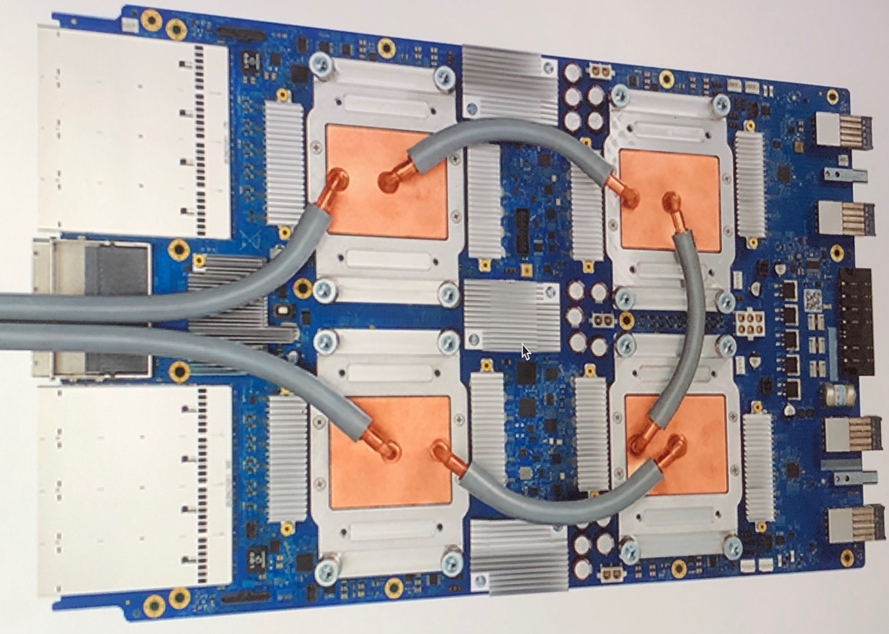
Google has used TPUs for Google Street View text processing, finding all the text in the Street View database in less than five days
In Google Photos, an individual TPU can process over 100 million photos a day
It is also used in RankBrain which Google uses to provide search results
Compared to a graphics processing unit (GPU), it is designed for a high volume of low precision computation (as little as 8-bit precision) with more input/output operations per joule, and lacks hardware for texture mapping

Slide 5
Introduction
To simplify the horrible mess that TensorFlow 1 was, TensorFlow 2 now integrates Keras
Keras is an open-source high-level package used as interface for TensorFlow instead of a separate library
Keras was already widely adopted
Google followed the path of “TF2 is basically Keras! Love us too as you love Keras”
TF2 is like an updated, more versatile version of Keras

Slide 6
Let’s “machine learning” with TensorFlow

Slide 7
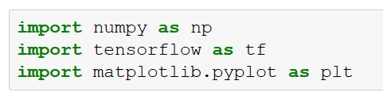
TensorFlow coding
The example showed here is similar to the previous one
However, using Numpy we would need around 100 LOC, while with TF2 we just need around 20!
Let’s start importing the libraries

Slide 8
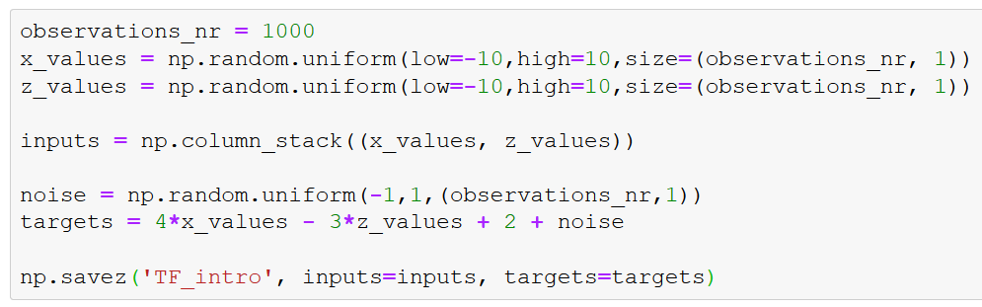
Generating random data
Very similar to the previous example, but one line

Slide 9
np.savez('TF_intro', inputs=inputs, targets=targets)
TensorFlow doesn’t work well with data stored in classic .csv or .xlxs files
It likes to work with tensors (and it makes certainly sense)
The extension that TF2 likes is .npz
This is a NumPy’s file type used to store n-dimensional arrays
For this reason, we need to preprocess data so to become an .npz file type
np.savez does just that

Slide 10
np.savez('TF_intro', inputs=inputs, targets=targets)
Input file name that will be created from the specified inputs and targets
Label to use for the inputs and where to get them from
Label to use for the targets and where to get them from

Slide 11
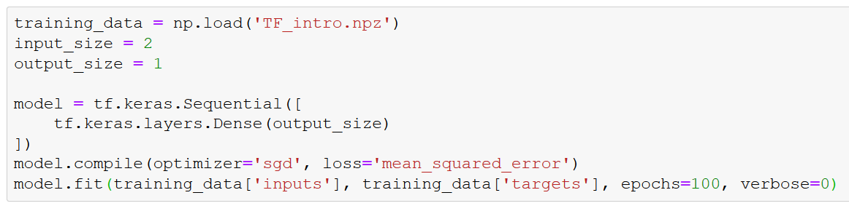
Now, let’s train the model
In the first line, we load the file created before
This is not strictly required (we already have the data), but we want to get used to it
This is what you will likely do very often, after all
training_data becomes an associative array with keys “inputs” and “targets”

Slide 12
The number of inputs is 2
In fact, we have two input variables, x and z
The number of output is 1
That is, y

Slide 13
With TensorFlow, we need to build the model
We are using Keras, which TF is based on
Sequential is a Keras function that indicates how the model will be generated
We basically define the output layer

Slide 14
We know that
output = np.dot(inputs, weights) + bias
We need to use the Keras function Dense on top of the layers
It takes the inputs to the model and calculates the dot product of the inputs and weights, adding the bias
It literally does what we achieved with np.dot

Slide 15
After taking care of the Data and Model, we need Optimization algorithm and Objective function
The compile method allows to specify both
Stochastic Gradient Descent (sgd) is a generalization of the Gradient Descent seen before (that was too simple…)
There are several optimizer that you can use: https://www.tensorflow.org/api_docs/python/tf/keras/optimizers

Slide 16
We want to use L2-Norm Loss here too
However, it is called “mean_squared_error”
We just add the string as parameter of the compile method

Slide 17
The last line is the fit function
It indicates to the model which data to fit
training_data contains the inputs and targets tensors, so we use it to specify them and feed fit
Finally, we set the number of iterations to 100
In TensorFlow we call them epochs

Slide 18
Let’s get an output out of this
If you run the code, you should get something that looks similar to this:
That’s not very informative
It just states that a model is stored in an object in memory
If you try setting verbose=1, you will see much more
It is technically a progress bar, but in text form…
Notes:
Note, there is also verbose=2 that doesn’t try to look like a progress bar

Slide 19
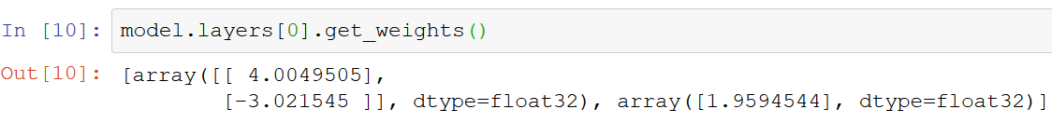
Let’s get an output out of this
We can check the weights and the biases in this way:
Note that we have only 1 layer, so the index [0] in model.layers[0]
The function get_weights returns both weights and biases

Slide 20
Let’s get an output out of this
We can check the weights and the biases in this way:
$$f\left(x,z\right)=4x−3z+2+noise$$

Slide 21
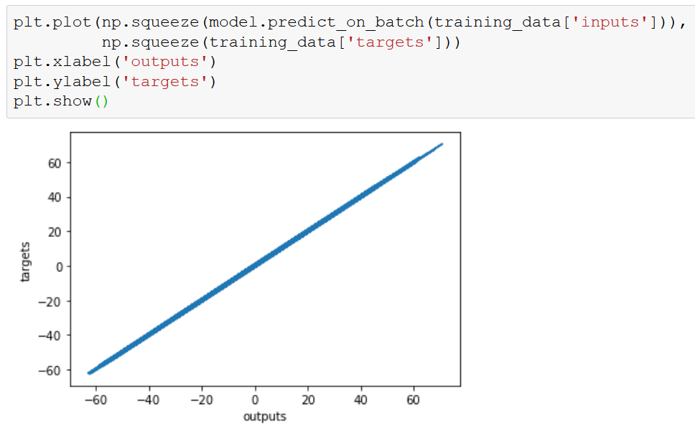
We can plot the data now:
The line should be as closer as possible to 45 degrees
That’s because the model’s output is very close to the target

Slide 22
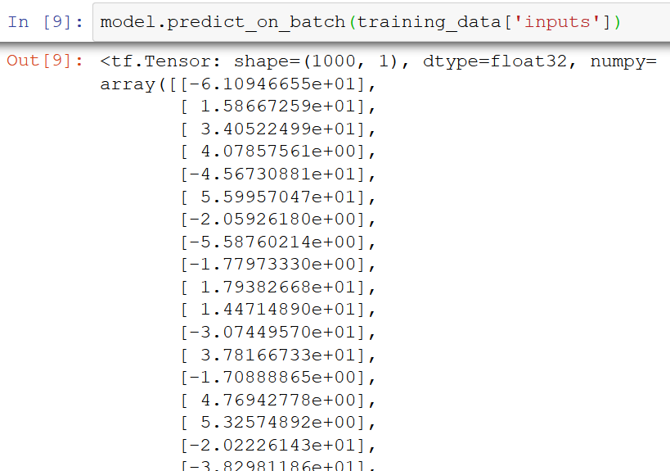
Extract the outputs
We want to extract the outputs to make predictions:
We obtain an array where each value corresponds to an input
These are the values compared to the targets and evaluated via the Loss function
In out example, the outputs are generated after 100 epochs of training

Slide 23
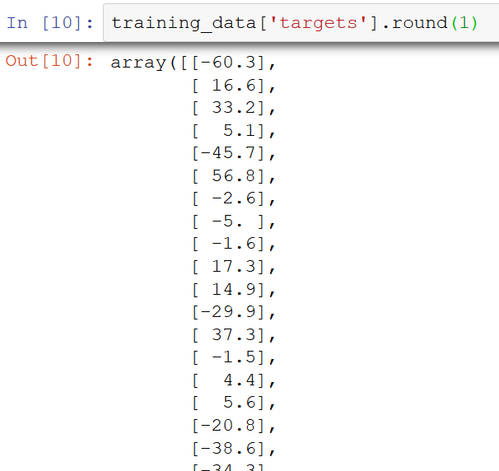
Extract the outputs
We want to extract the outputs to make predictions:
Now we try to compare them manually
Thus, we display the training targets and round all values to one digit after the dot
So they are easily readable
What we see is that the outputs and the targets are very close to each other but not exactly the same

Slide 24
Extract the outputs
We want to extract the outputs to make predictions:

Slide 25
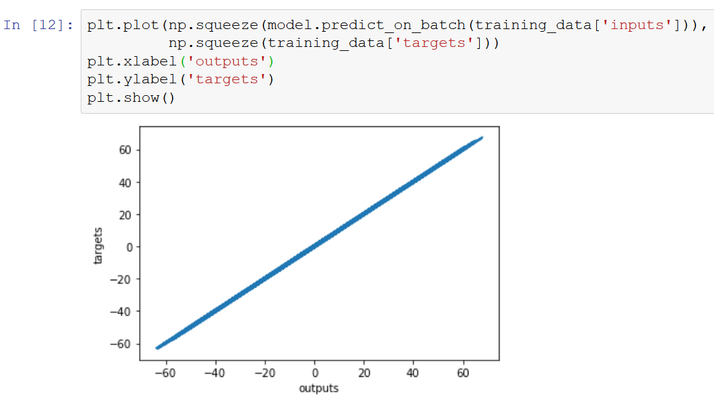
Plotting the targets against the outputs
Finally we can plot the outputs against the targets
We expect them to be very close to each other, thus, the line should be as close to 45 degrees as possible

Slide 26
Plotting the targets against the outputs
So, we have successfully built our first machine learning algorithm with Tensor Flow

Slide 27
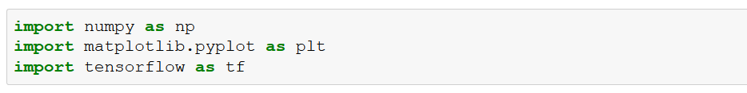
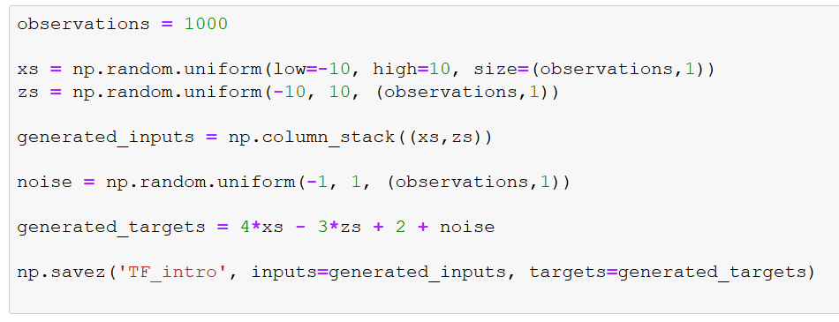
Customizing your model – Data generation
Notes:
First you need to set up the data, then you can run the code in the next slide

Slide 28
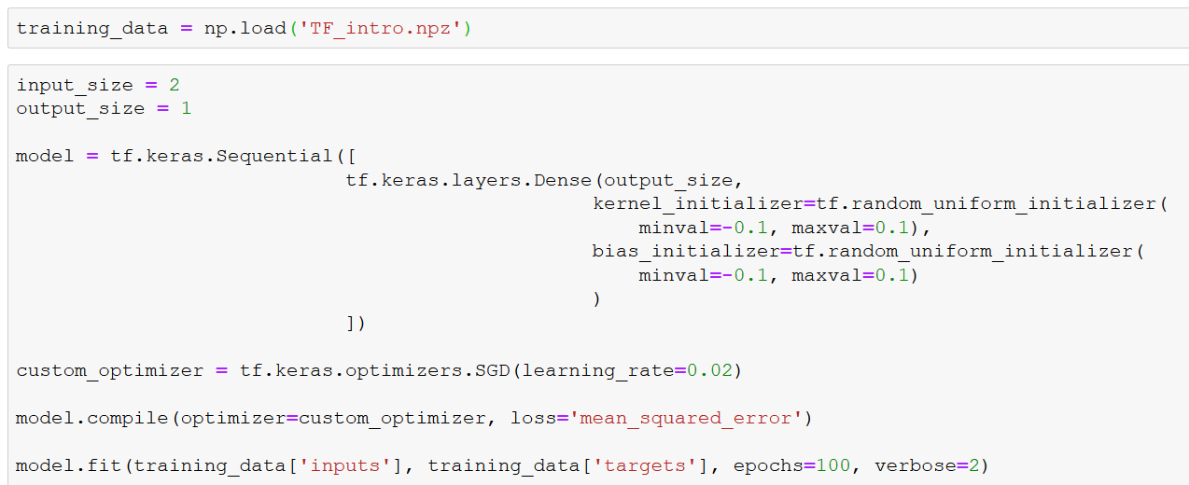
Customizing your model
Notes:
The rest of the code would remain the same. The output, after our customizations, should be very similar

Slide 29
Customizing your model
Basically, we can set a random uniform initializer, instead of inputting the starting values ourselves
We can add a kernel initializer and a bias initializer
Kernel here is the broader term for a weight

Slide 30
Customizing your model
We use Stochastic Gradient Descent, setting the learning rate to 0.02
NOTE: Here, instead of having the string “SGD”, you specify the variable ‘custom_optimizer’

Slide 31
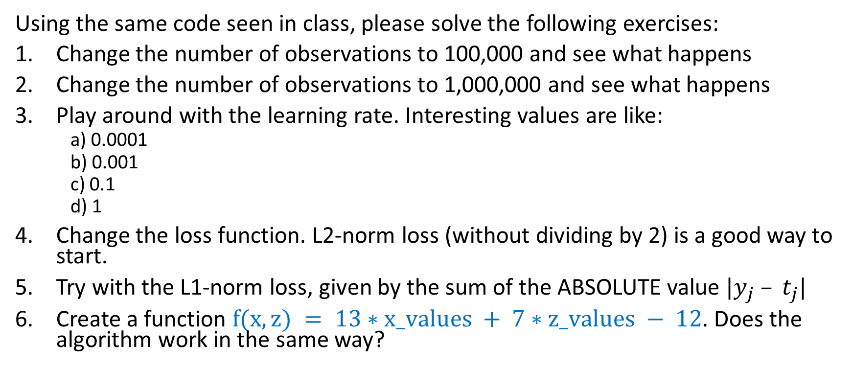
HW Assignment
Using the same code seen in class, please solve the following exercises:
Change the number of observations to 100,000 and see what happens
Change the number of observations to 1,000,000 and see what happens
Play around with the learning rate. Interesting values are like:
a) 0.0001
b) 0.001
c) 0.1
d) 1
Change the loss function. L2-norm loss (without dividing by 2) is a good way to start.
Try with the L1-norm loss, given by the sum of the ABSOLUTE value $|y_{j} – t_{j}|$
Create a function $f(x,z) = 13∗x_values + 7∗z_values − 12$. Does the algorithm work in the same way?

